Slide 1
We trust in the Community!
Ravikanth chaganti

Slide 2
5
Video operator, did you start the recording?
Notes:
[REQUIRED SLIDE]
These slides are mandatory and help us with video post-processing. Please keep them as they are.

Slide 3
4
Notes:
[REQUIRED SLIDE]

Slide 4
3
Notes:
[REQUIRED SLIDE]

Slide 5
2
Notes:
[REQUIRED SLIDE]

Slide 6
1
Notes:
[REQUIRED SLIDE]

Slide 7
We trust in the community!
Ravikanth Chaganti

Slide 8
Agenda
Community!
Community!
Community!
…
…
…
…
Community!

Slide 9
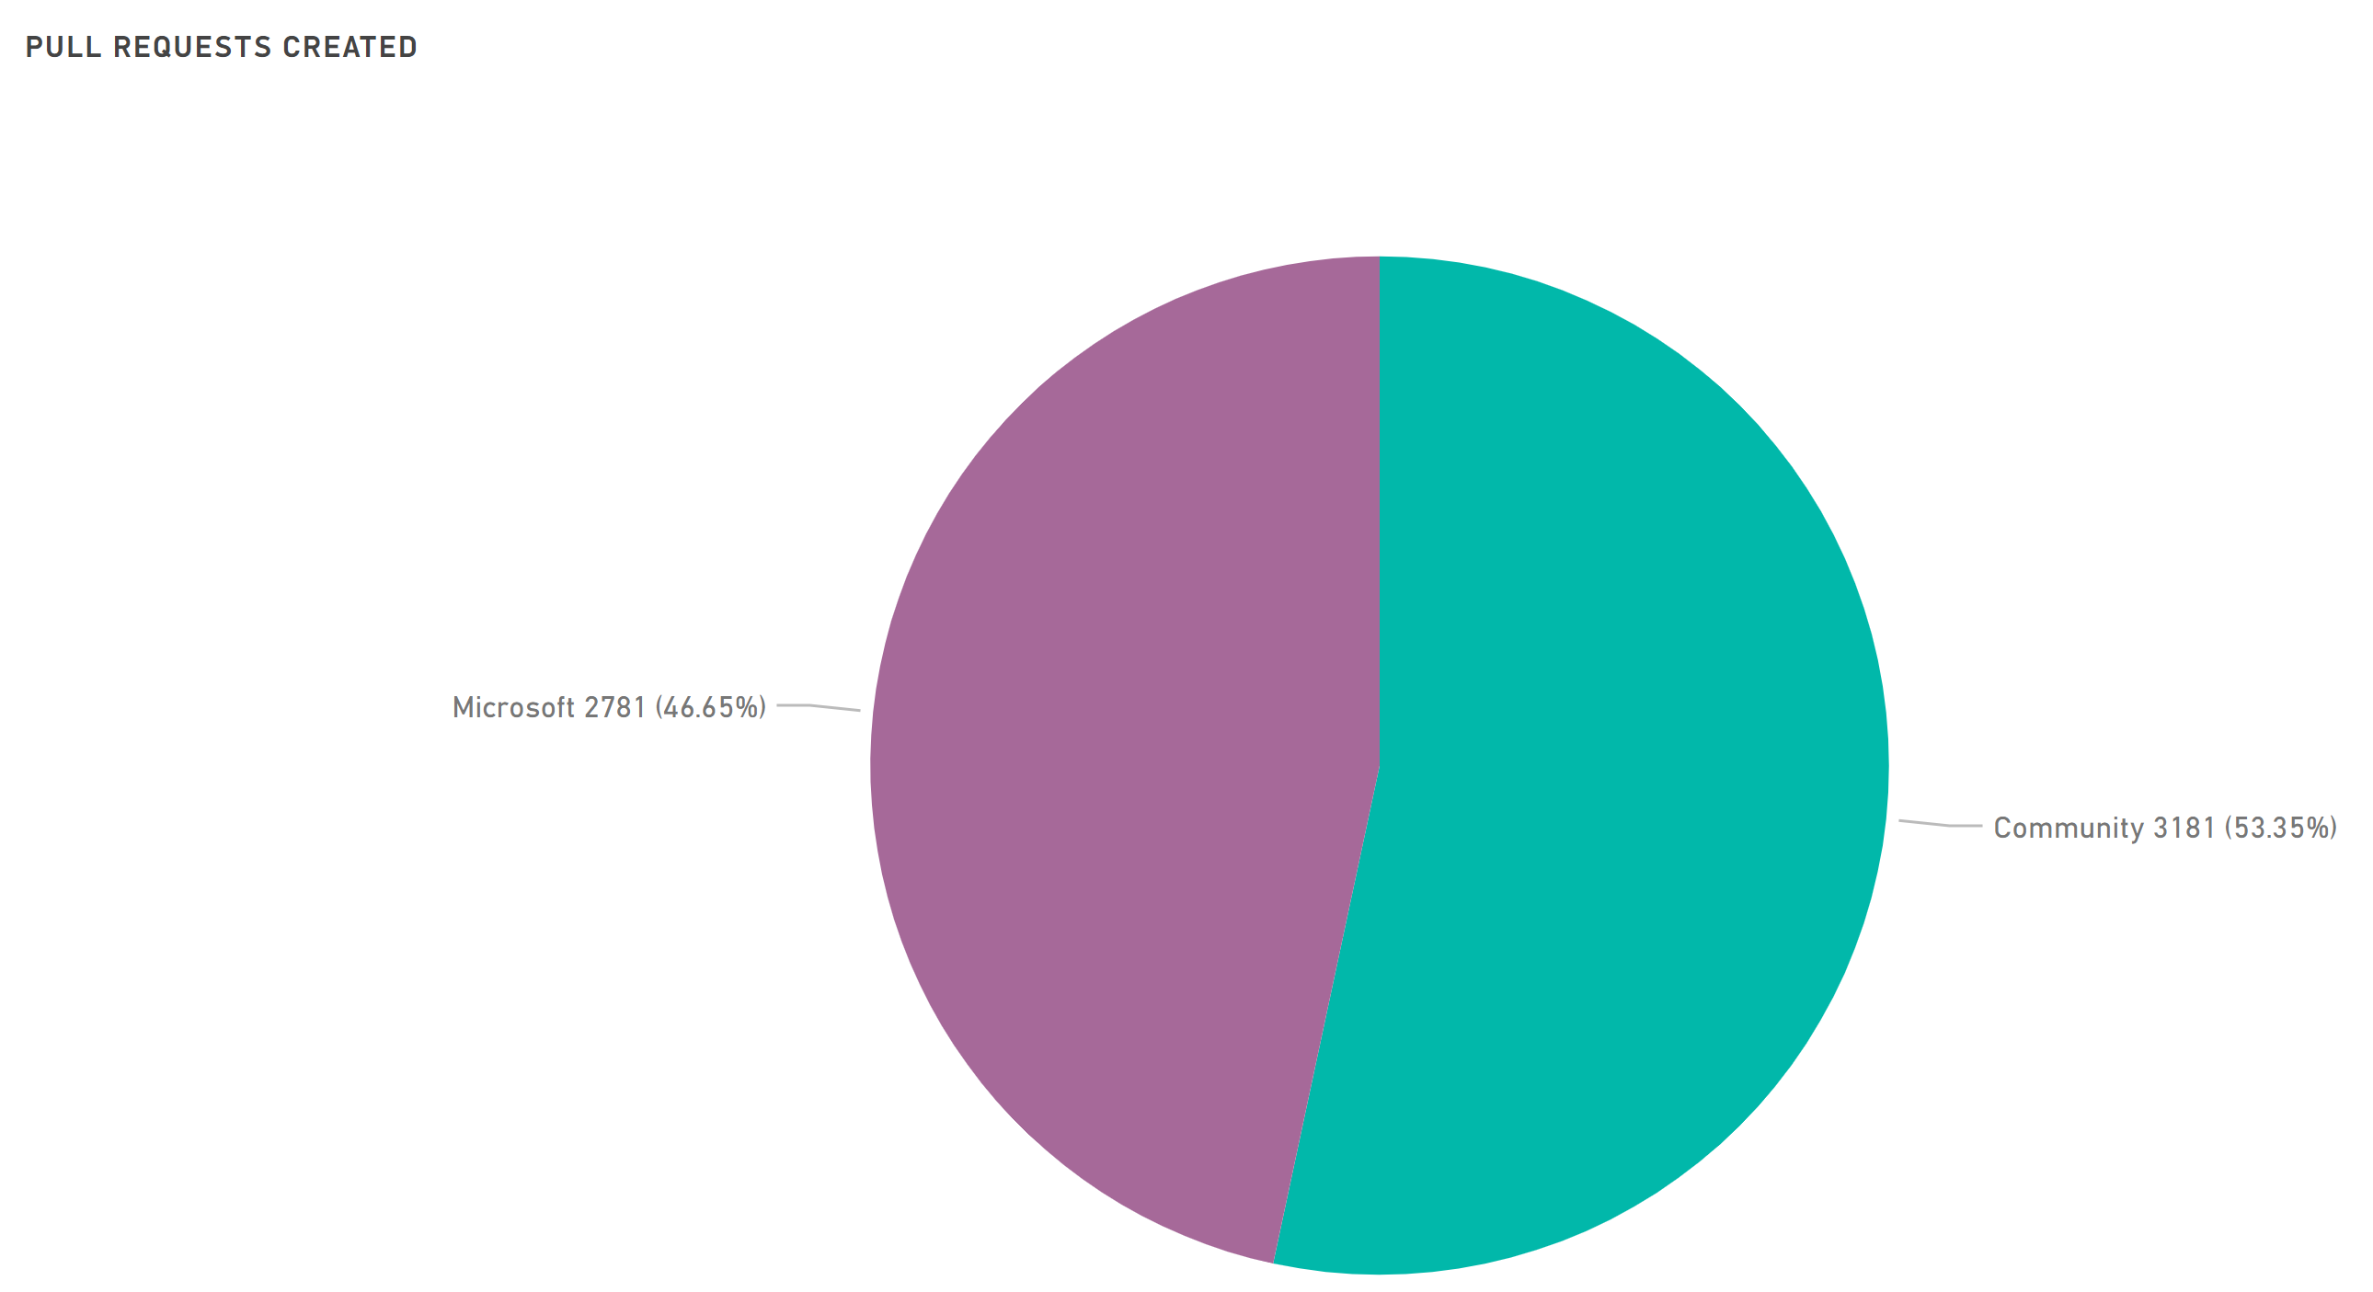
PowerShell Repository

Slide 10
Community Avenues
Community blogs
Books
Conferences / User Groups
Live Streamers
Forums
Community Open Source Modules

Slide 11
Community Open Source Modules
4K+ modules in PowerShell Gallery
100s more may be in GitHub repositories!

Slide 12
PSKoans
https://github.com/vexx32/PSKoans

Slide 13
Polaris and PSHTML

Slide 14
PSGraph

Slide 15
ImportExcel

Slide 16
Summary
The most powerful community
PowerShell Open Source Community Dashboard: http://aka.ms/PSGitHubBI

Slide 19
about_Speaker
Distinguished Member Technical Staff at Dell EMC
Multi-year Microsoft MVP (PowerShell)
Published Author
Founder and Editor of PowerShell Magazine
github.com/rchaganti
linkedin.com/in/rchaganti/

